Slide 1

OS Chapter 6
Prepared By : Sheetal J. Nagar,
Atmiya Institute of Technology & Science

Slide 2

Principles of I/O Hardware:
    I/O devices,
    Device controllers ,
    Direct memory access
Principles of I/O Software:
    Goals of Interrupt handlers ,
    Device drivers ,
    Device independent I/O software ,
Secondary-Storage Structure: Disk structure
Disk scheduling algorithm
RAID

Slide 3
Introduction
One of the main functions of OS is to control all the IO devices of the computer system.
OS hides internal complexity working of IO devices.

Slide 4

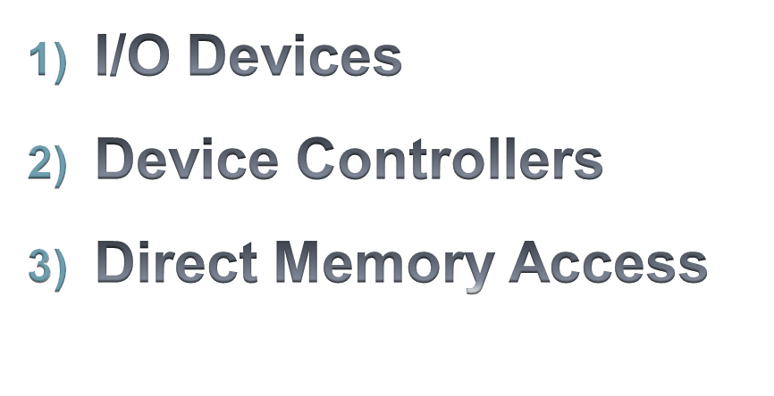

Slide 5
1) I/O devices
“The devices which are used for input and output purpose are known as I/O devices”
I/O devices can be roughly divided into two categories:
  block devices
  character devices.

Slide 6
I/O devices
Block devices
Character devices
“Stores information in fixed-size blocks”.
Each block has its own address.
Block size ranges from 512 to 65,536 bytes.
All transfers are in units of one or more consecutive blocks.
Each block can be accessed independent of all the others.
Ex. Hard disks, Blu-ray discs, and USB sticks
“A character device delivers or accepts a stream of characters, without regard to any block structure”.
It is not addressable and does not have any seek operation.
Example :Printers, network interfaces

Slide 7
Block Device
A block device is one that stores information in fixed-size blocks, each one with its own address.
Common block sizes range from 512 to 65,536 bytes.
All transfers are in units of one or more entire (consecutive) blocks.
Each block can be accessed independent of all the others.
Ex. Hard disks, Blu-ray discs, and USB sticks

Slide 8
Character Device
“A character device delivers or accepts a stream of characters, without regard to any block structure”.
It is not addressable and does not have any seek operation.
Example :Printers, network interfaces

Slide 9
2) Device controllers
I/O unit consist of a 2 components:
  1) Mechanical component : Device itself
  2) Electronic component : known as device controller
“Electronic component of I/O devices is called the Device Controller.”
The controller card usually has a connector on it, into which a cable leading to the device itself can be plugged.

Slide 10
Components of I/O devices
Mechanical component
Electronic component
Device itself
Known as
Device Controller

Slide 11
Controller's tasks :
Convert serial bit stream to block of bytes
perform error correction as necessary
Acts as an interface between device and OS
Each controller has few registers which are used for communicating with the CPU.
By writing into those registers, the OS can give commands to the device to do something, like turn on or turn off device, deliver data, accept data etc.

Slide 12
3) Direct Memory Access
The CPU can request data from an I/O controller one byte at a time, but doing so wastes the CPU’s time, so a different scheme, called DMA (Direct Memory Access) is often used.
We assume that the CPU accesses all devices and memory via a single system bus that connects the CPU, the memory, and the I/O devices.

Slide 13
3) Direct Memory Access
To explain how DMA works, let us first look at how disk reads occur when DMA is not used.
CPU requests the device controller to read one byte from the disk and transfer it into the RAM.
After receiving the request from the CPU, controller reads one byte from the disk and writes it in RAM.
After completing this for just one block, controller sends notification to the CPU that it has completed the transfer of one byte.
After receiving notification from the driver, CPU repeats steps 1) , 2) and 3) and completes the transfer of n number of blocks.

Slide 14
Disadvantages:
Here, CPU utilization is low, because after transfer of each block is completed, CPU has to send request again and again.
This concept is known as “Interrupt Driven I/O”.

Slide 15
3) Direct Memory Access
DMA
To overcome the problem occurring in the interrupt driven I/O, DMA can be used.
DMA utilizes CPU more than interrupt driven I/O.
In DMA CPU transfers the responsibility to DMA controller.
When DMA is used, the procedure is different.

Slide 16
When DMA is used things are as shown below.
CPU initiates the transfer and requests DMA controller to begin the transfer by sending starting address and total no. of blocks to read (count).
DMA controller requests Disk Controller to transfer the data from the disk to main memory.
After completing the transfer the Disk Controller gives acknowledge to DMA controller.
DMA controller will decrement the count by one.
If(count > 0) { Step 2) , 3) and 4) are repeated. }
else { DMA controller will acknowledge the CPU that reading task is completed. }

Slide 17
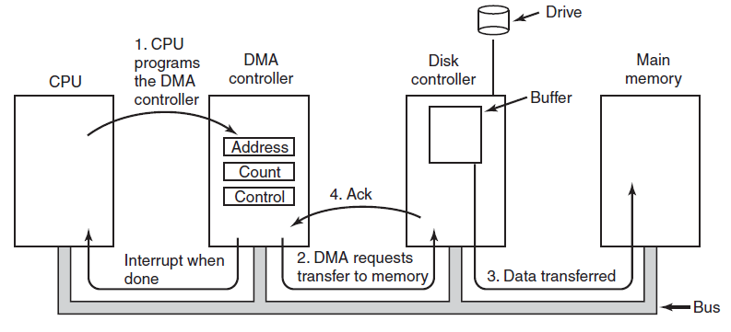


Figure : Operation of a DMA transfer
1. CPU programs the DMA controller
4. Ack
Interrupt
when done
2. DMA requests transfer to memory
3. Data transferred
count = count - 1
If(count > 0)
{ Step 2) , 3) and 4) are repeated. }
else
{ acknowledge the CPU that task is completed. }

Slide 18
Advantages:
CPU doesn’t receive acknowledgement after each block transfer like the case of interrupt driven I/O.
So, CPU can be utilized in better way than interrupt driven I/O.

Slide 19

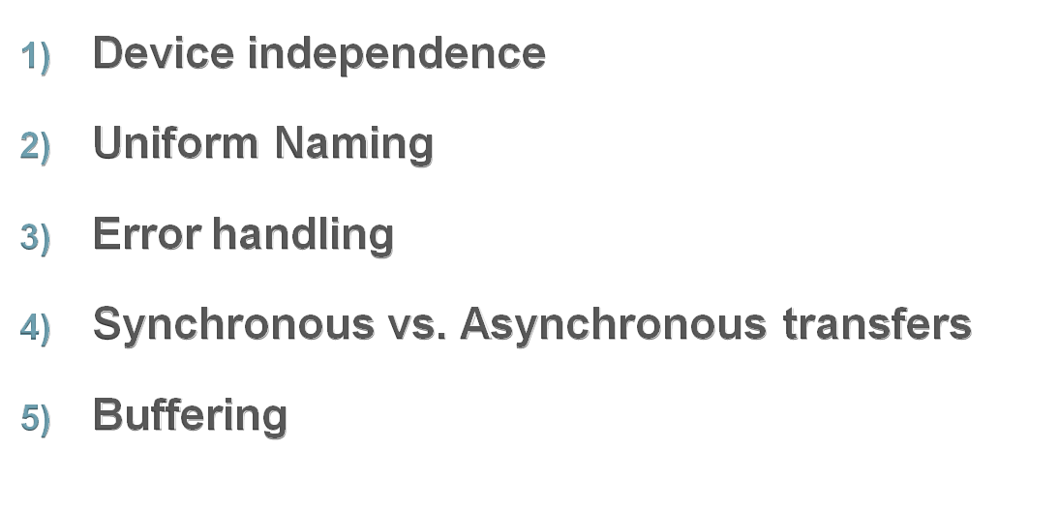

Slide 20
1) Device independence
A key concept in the design of I/O software is known as device independence.
It means we should be able to write i/o programs without having to specify the device in advance.
For example, a program that reads a file as input should be able to read a file on a hard disk, a DVD, or on a USB stick without having to be modified for each different device.
It is up to the operating system to take care of the problems caused by the fact that these devices really are different and require very different command sequences to read or write.

Slide 21
2) Uniform Naming
Closely related to device independence is the goal of uniform naming.
The name of a file or a device should simply be a string (or an integer) and not depend on the device.
All files and devices are addressed the same way: by a path name.

Slide 22
3) Error handling
In general, “errors should be handled as close to the hardware as possible”.
If the controller discovers a read error, it should try to correct the error itself if it can.
If it cannot, then the device driver should handle it.
Many errors are temporary, such as read errors caused by dust on the read head, and will frequently go away if the operation is repeated.
In many cases, error recovery can be done transparently at a low level without the upper levels even knowing about the error.

Slide 23
4) Synchronous vs. Asynchronous transfers
Synchronous means blocking transfer
Asynchronous means interrupt-driven transfers.
Most physical I/O is asynchronous—the CPU starts the transfer and goes off to do something else until the interrupt arrives.
User programs are much easier to write if the I/O operations are blocking—after a read system call the program is automatically suspended (blocked) until the data are available in the buffer.

Slide 24
5) Buffering
Often data that come from a device cannot be stored directly in their final destination.
For example, when a packet comes in from the network, the operating system does not know where to put it until it has stored the packet somewhere and examined it.
Buffering involves copying and often has a major impact on I/O performance.

Slide 25


Slide 26
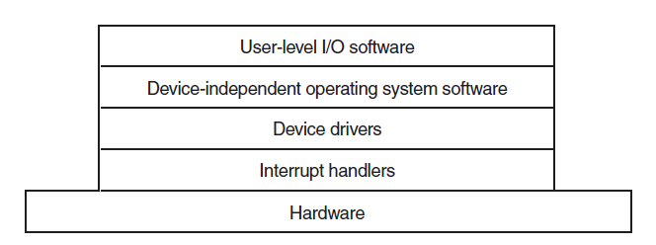
I/O Software Layers

Slide 27
1) Interrupt Handlers
Interrupt : “A signal that gets the attention of the CPU and is usually generated when I/O is required”.
For example:
Hardware interrupts are generated when a key is pressed or when the mouse is moved.
Software interrupts are generated by a program requiring disk input or output.
An internal timer may continually interrupt the computer several times per second to keep the time of day current or for timesharing purposes.

Slide 28
1) Interrupt Handlers
When an interrupt occurs, control is transferred to the operating system, which determines the action to be taken.
Interrupts play a major role to communicate between Device and CPU.
So we need to have a software layer which can handle the interrupts related to I/O device.

Slide 29
5) Interrupt Handlers
Steps:
CPU saves the state of currently executing process.
Stops current process.
Runs the interrupt-service procedure. It will extract information from the interrupting device controller’s registers. thus, it serves the new process by loading new data structure (Process table) of new process.
After serving the interrupt, again old process is started from the point it left.

Slide 30
2) Device Drivers
“Each I/O device attached to a computer needs some device-specific code for controlling it, This code is called as device driver”.
It is generally written by the device’s manufacturer and delivered along with the device.

Slide 31
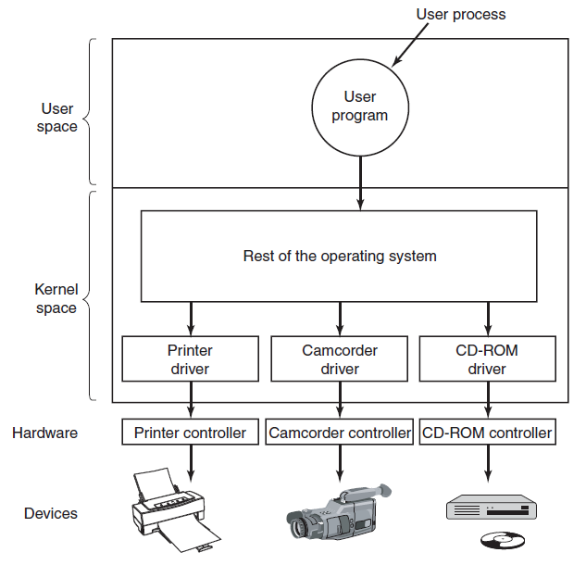
Device
Drivers
Printer
Driver
Camcorder
Driver
CD-ROM
Driver
Printer Controller
Camcorder Controller
CD-ROM Controller

Slide 32
Functions of device drivers
Device driver accept read and write requests from device
Device driver must initialize the device if needed.
It also checks statues of devices. If it is currently in use then queue the request for latter processing. If device is in idle state then request can be handled now.
Device driver writes the command sequence to the control register.
It provides error handling facility related to a particular I/O device.

Slide 33
3) Device-Independent I/O Software
As we know OS interfaces with different device drivers.
Each device has separate interface with OS and driver function of different device differ from driver to driver (and device to device).
It means interfacing with each new driver requires lot of new programming effort.
So we need a layer which can handle this issue and which is device independent.

Slide 34
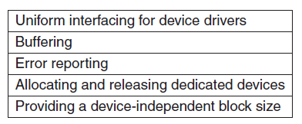
3) Device-Independent I/O Software

Slide 35
1) Uniform interfacing for device drivers
It provides uniform interface between OS and different device drivers.
If this layer is not included, the programming efforts are large to write different interface code for different drivers.

Slide 36
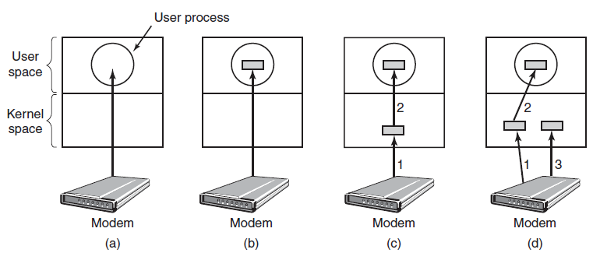
2) Buffering
I/O performance increases due to buffering capabilities.
Unbuffered input
Buffering in
the kernel
followed by
copying to
user space.
Buffering in
user space
Double buffering
in the kernel

Slide 37
3) Error reporting
Here, general errors are handled like :
  Writing to an input device (keyboard, mouse, scanner)
  Reading from an output device (Printer, Plotter)
  Specifying invalid device to use (Ex. trying to access Disk3, while system has only 2 Disks).
Another class of the errors:
  Trying to read/write a disk block that has been damaged.
  Trying to read from a camcorder that has been switched off.
In this case it is up to the device driver to decide what to do. If the driver doesn’t know what to do, it may pass the problem to the device independent I/O software.

Slide 38
4) Allocating and releasing Devices
Some devices such as CD-ROM recorders can be used only by a single process at any given moment.
A mechanism for requesting and releasing dedicated devices is required.
5) Providing a device-independent block size
Different disks may have different sector sizes.
It is up to the device independent I/O software to hide
this fact and provide a uniform block size to higher layers.

Slide 39


Slide 40


Slide 41
Disk Structure
Each disk platter has a flat circular shape, like a CD. The two surfaces of a platter are covered with a magnetic material.
The heads are attached to a disk arm that moves all the heads as a unit.
The surface of a platter is logically divided into circular tracks, which are subdivided into sectors.
The set of tracks that are at one arm position makes up a cylinder.
There may be thousands of cylinders in a disk drive, and each track may contain hundreds of sectors.
Modern disk drives are addressed as large one-dimensional arrays of logical blocks, where the logical block is the smallest unit of transfer.
The size of a logical block is usually 512 bytes, although some disks can have a different logical block size, such as 1024 bytes.

Slide 42

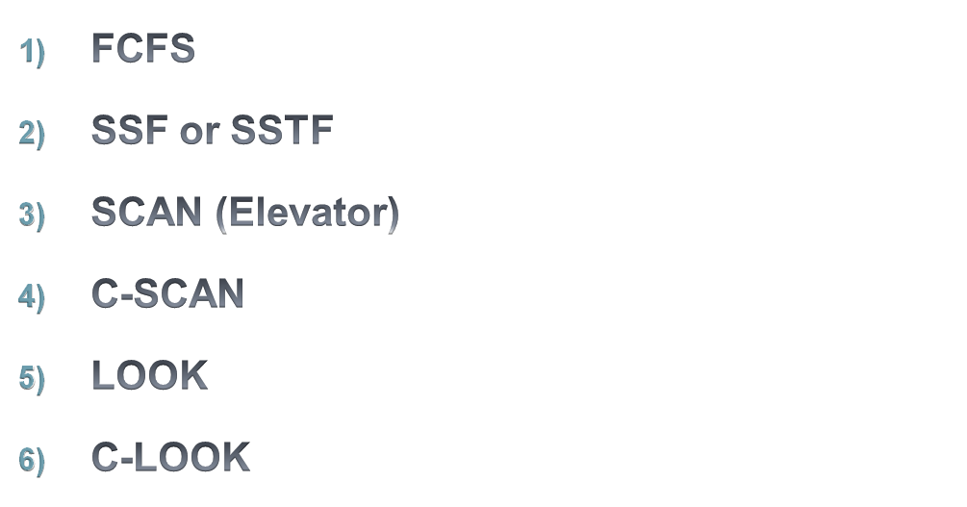

Slide 43
Disk Arm Scheduling Algorithms
Let’s consider how long it takes to read or write a disk block.
The time required is determined by three factors:
  Seek time – “the time to move the arm to the proper cylinder”
  Rotational delay – “Time for the proper sector to appear under the reading head”
  Actual data transfer time.
For most disks, the seek time dominates the other two times,
so reducing the mean seek time can improve system performance substantially.

Slide 44
1) FCFS (First-Come, First-Served)
“The request that comes first is served first”.
If the disk driver accepts requests one at a time and carries them out in that order, that is, FCFS.

Slide 45
FCFS Example:
Current Cylinder Position: 11
Cylinder Request: 1, 36, 16, 34, 9, 12
Total Number of Cylinders: 40
Find Total Arm Movement.
If 1 seek takes 6 ms then find total seek time for FCFS algo.

Slide 46
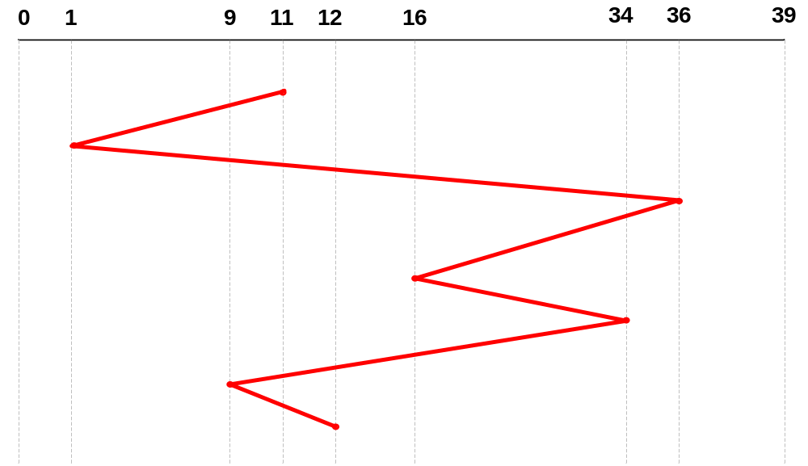
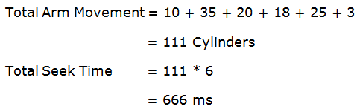

Slide 47
2) SSF (Shortest Seek First) or
SSTF (Shortest Seek Time First)
The SSTF algorithm selects the request with the minimum seek time from the current head position.
It always handles the closest request next, to minimize seek time.

Slide 48
SSTF Example:
Current Cylinder Position: 11
Cylinder Request: 1, 36, 16, 34, 9, 12
Total Number of Cylinders: 40
Find Total Arm Movement.
If 1 seek takes 6 ms then find total seek time for SSTF algo.

Slide 49
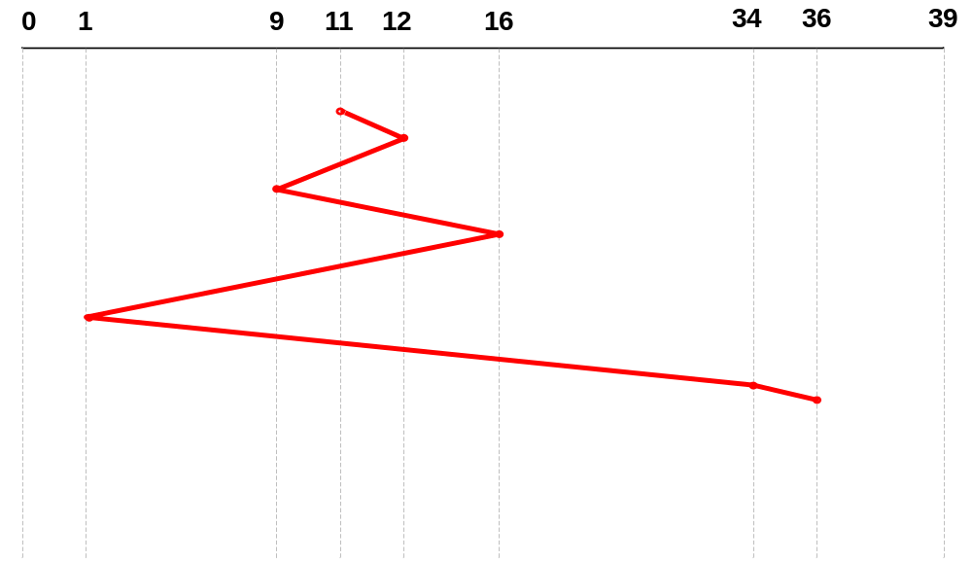
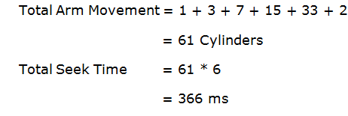

Slide 50
3) SCAN or Elevator
This algorithm works on the basic concept of elevator.
“The arm starts moving in one direction (upward or downward) and serves all the requests coming in its path.
After reaching to one end of disk, it reverses the direction and again serves all the remaining requests coming in its path”.

Slide 51
SCAN Example:
Current Cylinder Position: 11
Cylinder Request: 1, 36, 16, 34, 9, 12
Total Number of Cylinders: 40
Find Total Arm Movement.
If 1 seek takes 6 ms then find total seek time for SCAN algo.

Slide 52
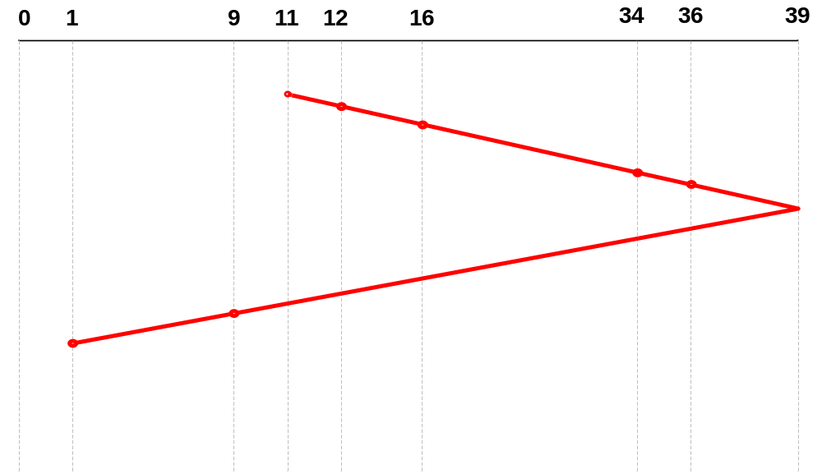
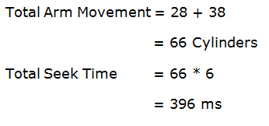

Slide 53
4) C-SCAN
It works in the same way as SCAN with little changes as follows:
“After reaching to One Disk End, it directly jumps to the Other End, without serving any request along that path ”.
After reaching to that end again starts serving all the requests along that path.

Slide 54
C-SCAN Example:
Current Cylinder Position: 11
Cylinder Request: 1, 36, 16, 34, 9, 12
Total Number of Cylinders: 40
Find Total Arm Movement.
If 1 seek takes 6 ms then find total seek time for C-SCAN algo.

Slide 55
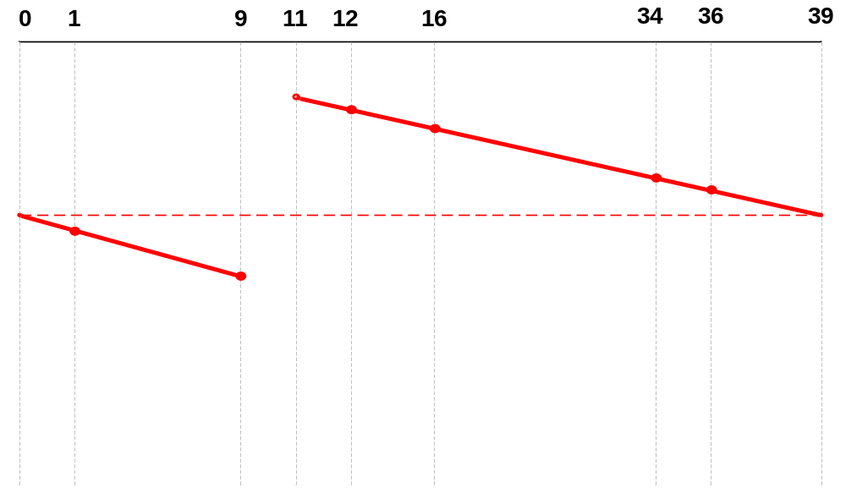
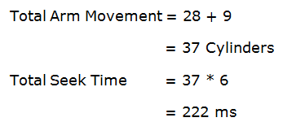

Slide 56
5) LOOK
It is an enhanced version of SCAN algorithm.
“The arm starts moving in one direction (upward or downward) and serves all the requests coming in its path.
After reaching to last request in one direction of disk, it reverses the direction and again serves all the remaining requests coming in its path”.

Slide 57
LOOK Example:
Current Cylinder Position: 11
Cylinder Request: 1, 36, 16, 34, 9, 12
Total Number of Cylinders: 40
Find Total Arm Movement.
If 1 seek takes 6 ms then find total seek time for LOOK algo.

Slide 58
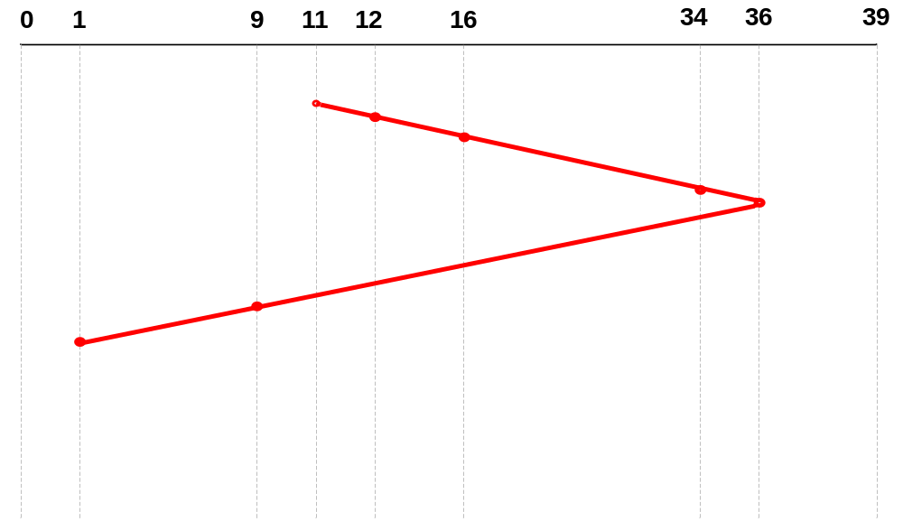
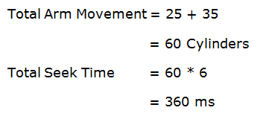

Slide 59
6) C-LOOK (Circular - LOOK)
It works in the same way as SCAN with little changes as follows:
“After reaching to the last request in one direction, it directly jumps to the last request in the opposite direction, without serving any request along that path ”.

Slide 60
C-LOOK Example:
Current Cylinder Position: 11
Cylinder Request: 1, 36, 16, 34, 9, 12
Total Number of Cylinders: 40
Find Total Arm Movement.
If 1 seek takes 6 ms then find total seek time for C-LOOK algo.

Slide 61
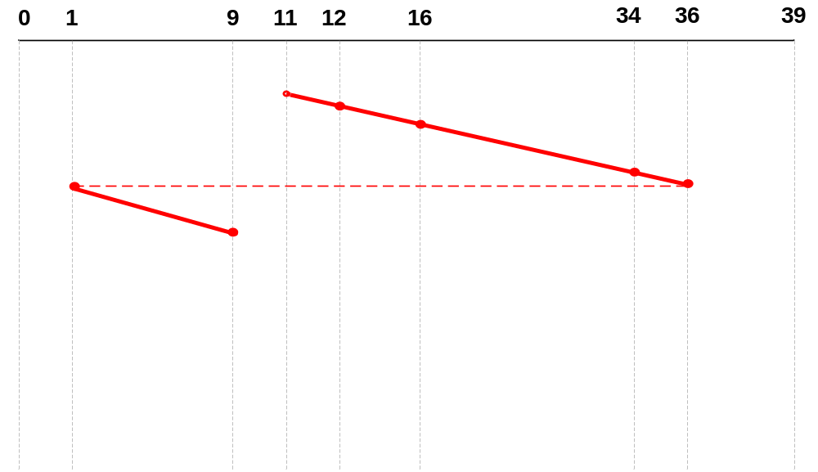
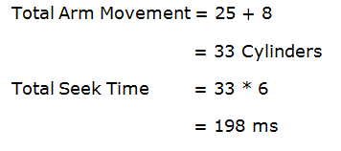

Slide 62


Slide 63

RAID
RAID is “Redundant Array of Independent Disks”.
Parallel processing is being used to speed up CPU performance.
Nowadays, most manufacturers refer to the seven standard configurations as RAID level 0 through RAID level 6 to achieve parallel processing.
Here actually there is no hierarchy but the term ‘‘level’’ simply indicates seven different organizations possible.

Slide 64
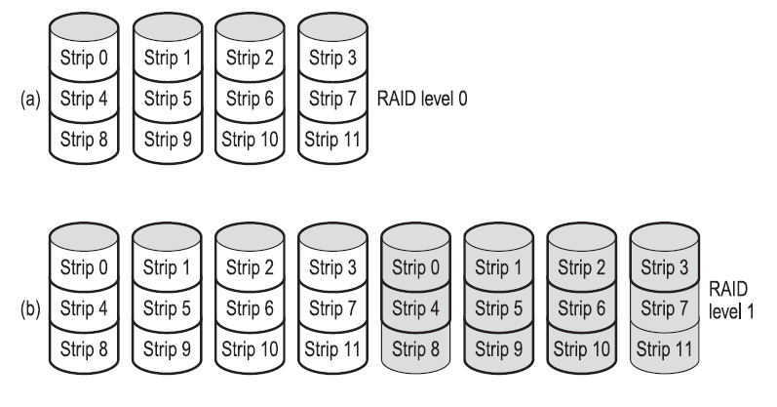
RAID Level 0

Slide 65
RAID Level 0
“single disk is divided up into strips of k sectors each, with
sectors 0 to k - 1 being strip 0,
sectors k to 2k - 1 strip 1, and so on.
Distributing data over multiple drives like this is called striping”.
Performance is excellent and the implementation is straightforward.
Disadvantage of RAID level 0 is that the reliability is potentially worse than having a SLED (Single Large Expensive Disk).

Slide 66
RAID Level 1

Slide 67
RAID Level 1
It duplicates all the disks.
so there are four primary disks and four backup disks.
On a write, every strip is written twice.
On a read, either copy can be used.
Consequently, write performance is no better than for a single drive, but read performance can be up to twice as good.
Fault tolerance is excellent: if a drive crashes, the copy is simply used instead.
Recovery consists of simply installing a new drive and copying the entire backup drive to it.

Slide 68
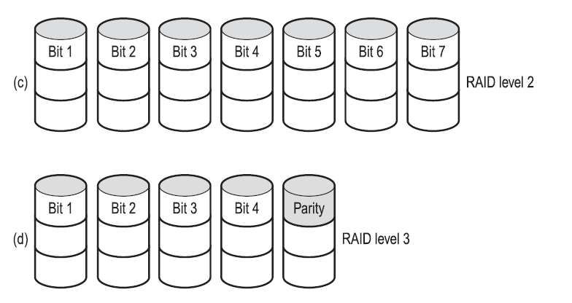
RAID Level 2

Slide 69
RAID Level 2
RAID level 2 works on a word basis, possibly even a byte basis.
Imagine splitting each byte into a pair of 4-bit nibbles, then adding a Hamming code to each one to form a 7-bit word (of which bits 1, 2, and 4 were parity bits).
Hamming code is used for error correction and detection.
All seven drives need to be synchronized in terms of arm position and rotational position.

Slide 70
RAID Level 3
Parity

Slide 71
RAID Level 3
RAID level 3 is a simplified version of RAID level 2.
Here a single parity bit is computed for each data word and written to a parity drive.
As in RAID level 2, the drives must be exactly synchronized, since individual data words are spread over multiple drives.
In the case of a drive crashing, it provides full 1-bit error correction since the position of the bad bit is known.

Slide 72
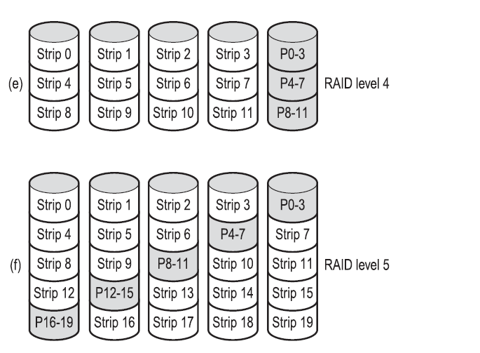
RAID Level 4
P(0-3)
P(4-7)
P(8-11)

Slide 73
RAID Level 4
It like RAID level 0, with a strip-for-strip parity written onto an extra drive.
All the strips are EXCLUSIVE ORed together, resulting in a parity strip k bytes long.
  XOR ( 1111 , 1001 , 1010 , 0000 ) = 1100
If drive 2 crashes which contains data 1001, then it can be computed by performing XOR operation from remaining 3 disks and parity disk.
For Recovery perform following:
XOR ( 1111 , 1010 , 0000 , 1100 ) = 1001
Disadvantage : If one sector is changed, it is necessary to read all the drives in order to recalculate the parity, which must then be rewritten. Thus, parity drive may become a bottleneck.

Slide 74
RAID Level 5
P(0-3)
P(4-7)
P(8-11)
P(12-15)
P(16-19)

Slide 75
RAID Level 5
The bottleneck problem of level 4 is eliminated in RAID level 5 by distributing the parity bits uniformly over all the drives, round-robin fashion.
However, in the event of a drive crash, reconstructing the contents of the failed drive is a complex process.

Slide 76
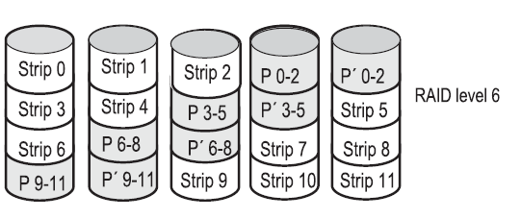
RAID Level 6
P(0-2)
P’(0-2)
P(3-5)
P’(3-5)
P(6-8)
P’(6-8)
P(9-11)
P’(9-11)

Slide 77
RAID Level 5
Raid level 6 is similar to RAID level 5, except that an additional parity block is used.
In other words, the data is striped across the disks with two parity blocks instead of one.
As a result, writes are bit more expensive because of the parity calculations, but reading operation offers more reliability.

Slide 78
Reference Books:
    “Operating System Concepts” by Silberschatz, Peter B. Galvin and Greg Gagne
    “Modern Operating Systems” by Andrew S Tanenbaum

Slide 79


